Slide 1
MSoC Final Project Report Key-enabled Secure Access and Execution Environment for Vehicles (KSAE)
Team 16
R08943112 王佐育
R08943169 葛顯峯
R08943171 石文緯
GitHub: https://github.com/Wen-Wei0914/2020_MSOC_FINAL

Slide 2
Outline
Introduction to keyless entry systems
Security concerns of keyless entry systems
Why using high level synthesis (HLS)
Introduction of Key-enabled Secure Access and Execution Environment for Vehicles (KSAE)
HLS optimizations
Security analysis of KSAE
Conclusion

Slide 3
Introduction to Keyless Entry System

Slide 4




Introduction to Keyless Entry System
Carry the Key Fob
Unlock the Vehicle
Lock the Vehicle
v
v
v
The user carries the key fob and approaches the vehicle.
When the user/key fob is within certain range to the vehicle, the doors automatically unlock themselves.
The doors lock themselves again on the leaving of the user/key fob.
Icon source: https://thenounproject.com/

Slide 5
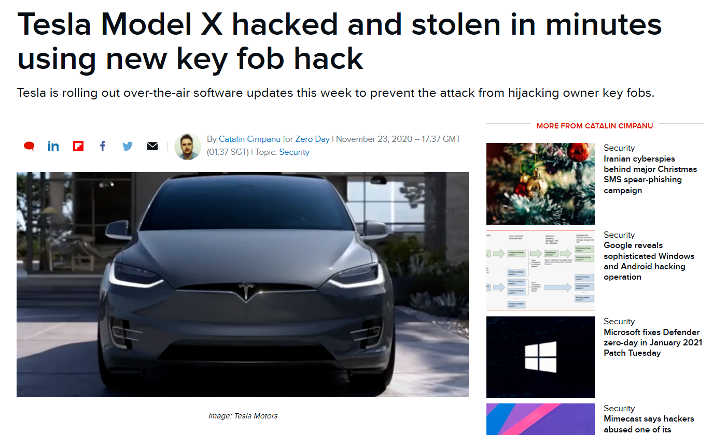
Security Concerns of Keyless Entry Systems
News source: https://www.zdnet.com/article/tesla-model-x-hacked-and-stolen-in-minutes-using-new-key-fob-hack/
Notes:
https://www.zdnet.com/article/tesla-model-x-hacked-and-stolen-in-minutes-using-new-key-fob-hack/

Slide 6
Why Using High-Level Synthesis

Slide 7
Why Using High-Level Synthesis
Advanced cryptography algorithms are mostly implemented in the form of software, HLS provides a quick and neat design methodology for converting such algorithms into hardware implementation
Frequent changes in the design of secure architecture for embedded systems are time-consuming yet desperately needed, HLS design flow reduces a marvelous amount of time whenever the architecture requires a modification
HLS also provides a rather simple approach for the integration between different algorithms at the early age of design flow, making changing design according to specification modification much feasible and effortless

Slide 8
Introduction of Key-enabled Secure Access and Execution Environment for Vehicles (KSAE)

Slide 9
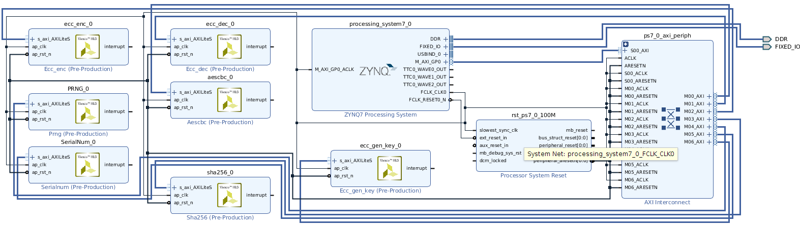
Block Design of the System

Slide 10
State Transition Diagram of KSAE
Sleep Mode
Not accepting any challenge while running in low power mode
Waiting for Command
The key fob waits for the challenge from the vehicle
Read & Send Digest
The key fob reads the received command and sends back digest accordingly
Build & Send Response
The key fob builds and sends the corresponding response back to the vehicle
Idle
Idle for a short period of time according to current condition
Motion Sensor Triggered
Sleep Mode
Waiting for
Command
No Trigger within 1 min
Idle for 0.5 sec
Challenge
Idle
Request
Digest
Build & Send
Response
Read & Send
Digest

Slide 11
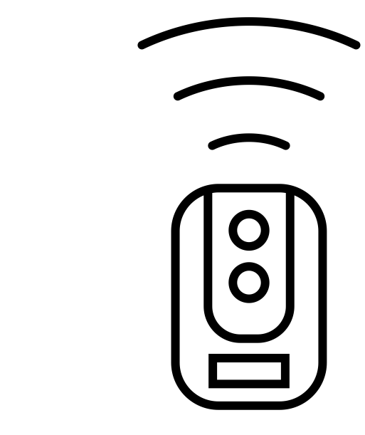

Operation Scenario of KSAE
Secure Execution
Door Unlock
Secure Execution
Build
Response
(Asymmetric)
Sleep Mode
Waiting for
Challenge
Motion Sensor Triggered
Send
Challenge
Send
Response
Door handle Triggered
Verification
passed
Sleep Mode
Build
Challenge
(Asymmetric)
Verify
Response
(Asymmetric)
Icon resource: https://thenounproject.com/

Slide 12
Operation Scenario of KSAE
Secure Execution
Build
Response
(Symmetric)
Read
Dig_{Motor}
Send
Challenge
Send
Response
Request
Dig_{Motor}
Return
Dig_{Motor}
Verification
passed
Verification
passed
Open
Door
&
Build
Challenge
(Symmetric)
Verify
Response
(Symmetric)
Integrity
Verification
(Motor
Control
Program)
Calculate
Dig_{Motor}
Match?
Motor
on
*Dig_{Motor}: HMAC (Keyed-hash message authentication code) Digest of Motor Control Program

Slide 13
HLS Optimization of KSAE

Slide 14
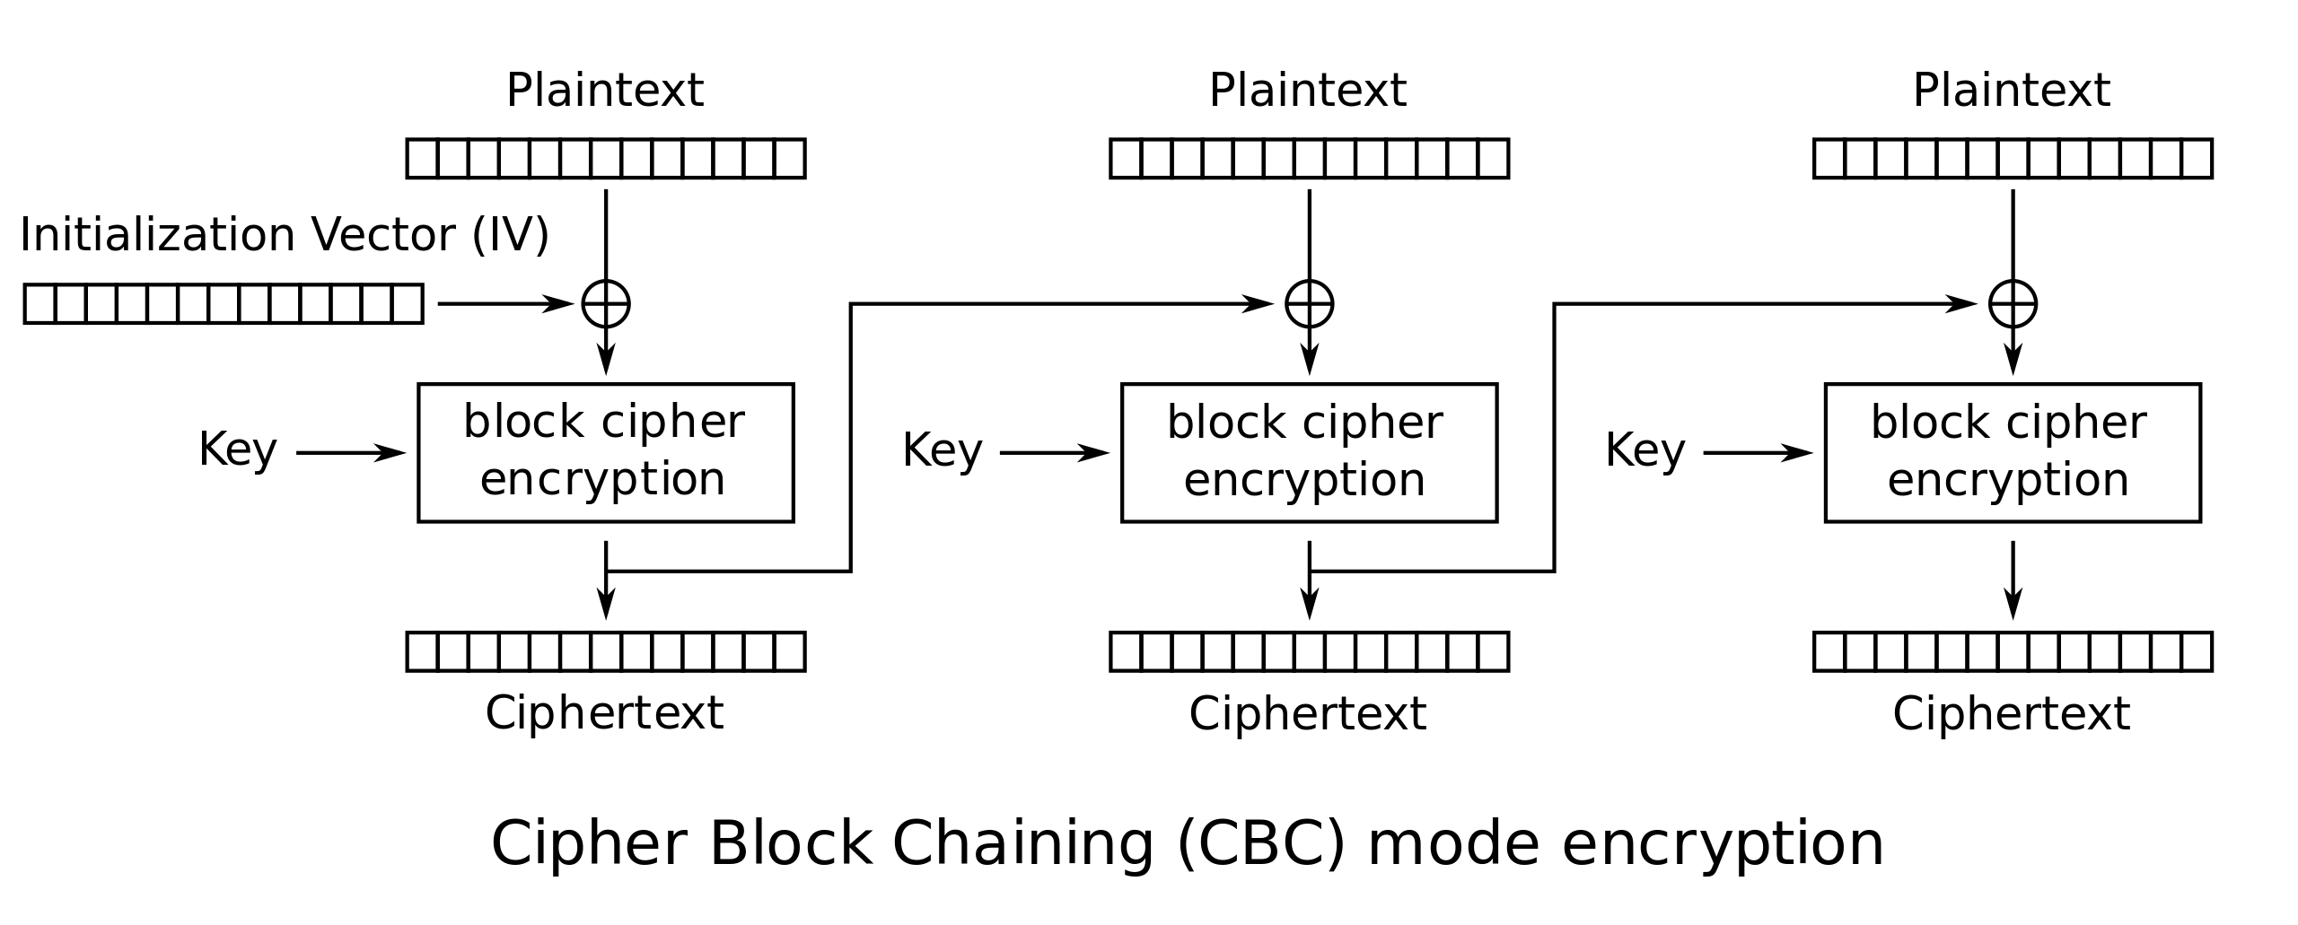
HLS Optimization of KSAE
Source: https://en.wikipedia.org/wiki/Block_cipher_mode_of_operation

Slide 15
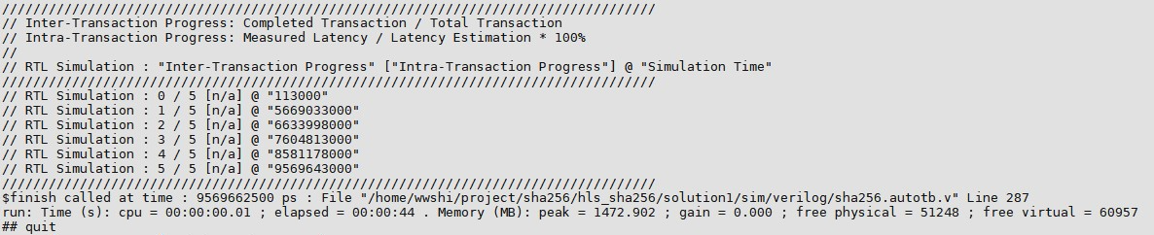
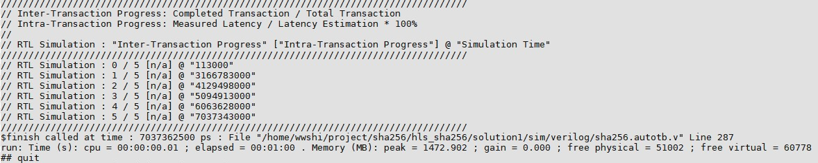
HLS Optimization of KSAE
Example 1. SHA-256 (Secure Hash Algorithm)
-> approx. 26% time reduction

Slide 16
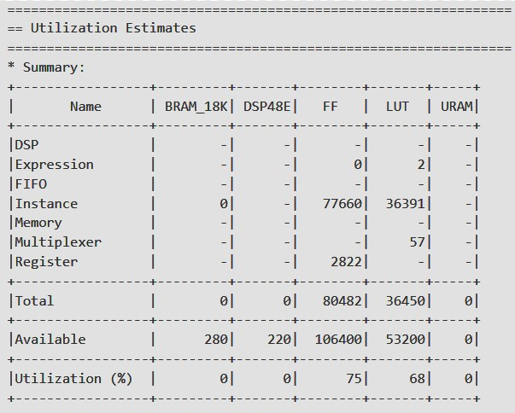
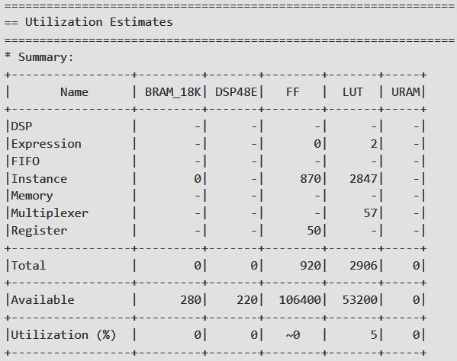
HLS Optimization of KSAE
Example 2. ECC (Elliptic Curve Cryptography) encryption

Slide 17
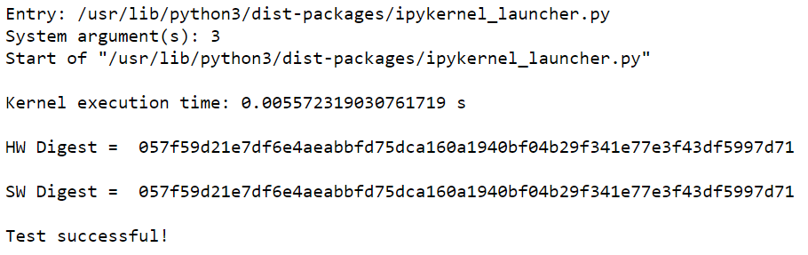
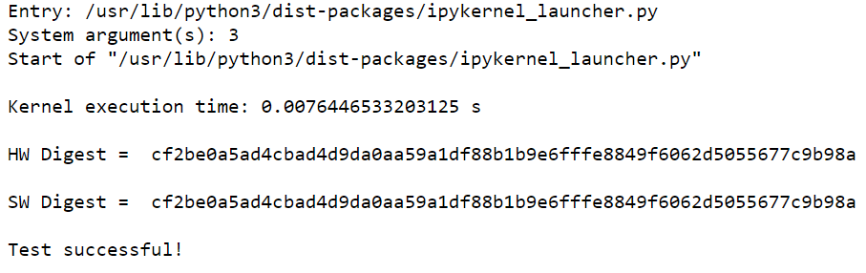
HLS Optimization of KSAE
-> approx. 27% time reduction
Overall timing improvement

Slide 18
Security Analysis of KSAE

Slide 19
Common Attacks for Keyless Entry Systems
Scan attack:
Scans for information stored on embedded systems
Replay attack:
Replays previous valid response for trespassing verification
Challenge forward prediction attack:
Observes sent challenges and predicts possible challenges
Dictionary attack:
Stores challenge-response pairs and responds accordingly
Relay attack:
Intercepts transmission between devices and tricks the receiver
with intercepted signal

Slide 20
Security Analysis
Claim 1.
The proposed KSAE prevents challenge forward prediction attack.
Proof.
The challenges in our protocol is generated through PUF, whose randomness passes the Cryptographic Validation Program (CAVP) of National Institute of Standards and Technology (NIST).
The challenges are therefore unpredictable and the seed value is renewed whenever the system enters sleep mode.

Slide 21
Security Analysis
Claim 2.
The proposed KSAE raises the difficulty of scan attack.
Proof.
The KSAE idles for 0.5 seconds whenever a faulty response is received, making the scan attack a rather time-consuming process which greatly raises the computing time of scan attack, disregard of computing capacity of the attacker’s equipment.

Slide 22
Security Analysis
Claim 3.
The secret keys are not revealed to the attackers.
Proof.
The secret keys used during the operation is stored within the Zynq-7000 SoC of ZedBoard and not transferred outside of the chip, making it impossible to probe the secret unless by de-capping the chip, which will possibly sabotage the chip

Slide 23
Conclusion
HLS tremendously reduces the design time for secure embedded systems
HLS also provides a quick and neat design flow for systems that require frequent change in architecture during design
Several different solutions are tried and an qualified final version was built with the time reduction of 27%

Slide 24
Thank You

Slide 25
Appendix

Slide 26
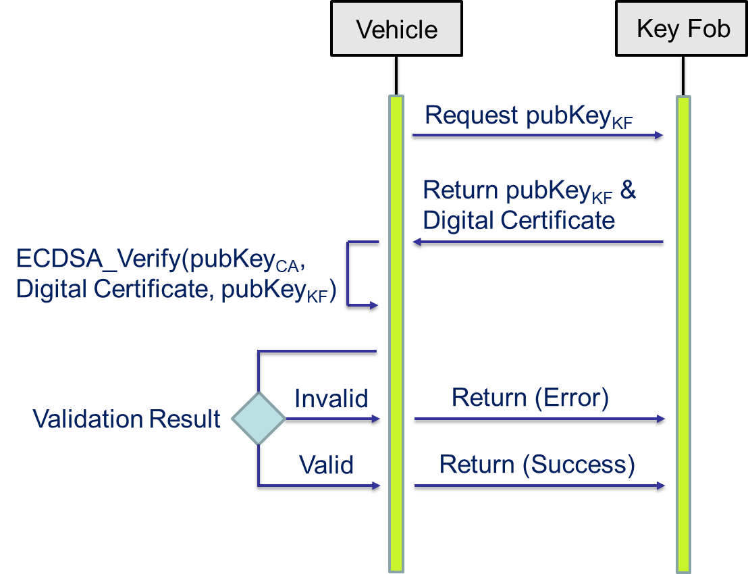
Appendix A.1 Public Key Certificate Verification

Slide 27
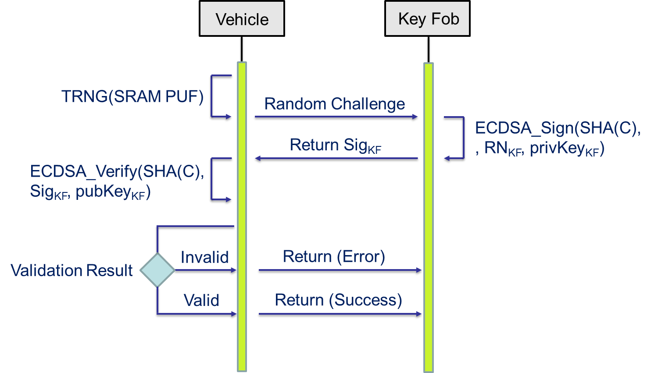
Appendix A.2 Key Fob Asymmetric Authentication
*privKey_{KF}: Private Key of Key Fob
*pubKey_{KF}: Public Key of Key Fob
*TRNG: True Random Number Generator
*SHA(C): SHA-256(Challenge)
*Sig_{KF}: Digital Signature of ECDSA_Sign
*RN_{KF}: Random Number generated by
Key Fob

Slide 28
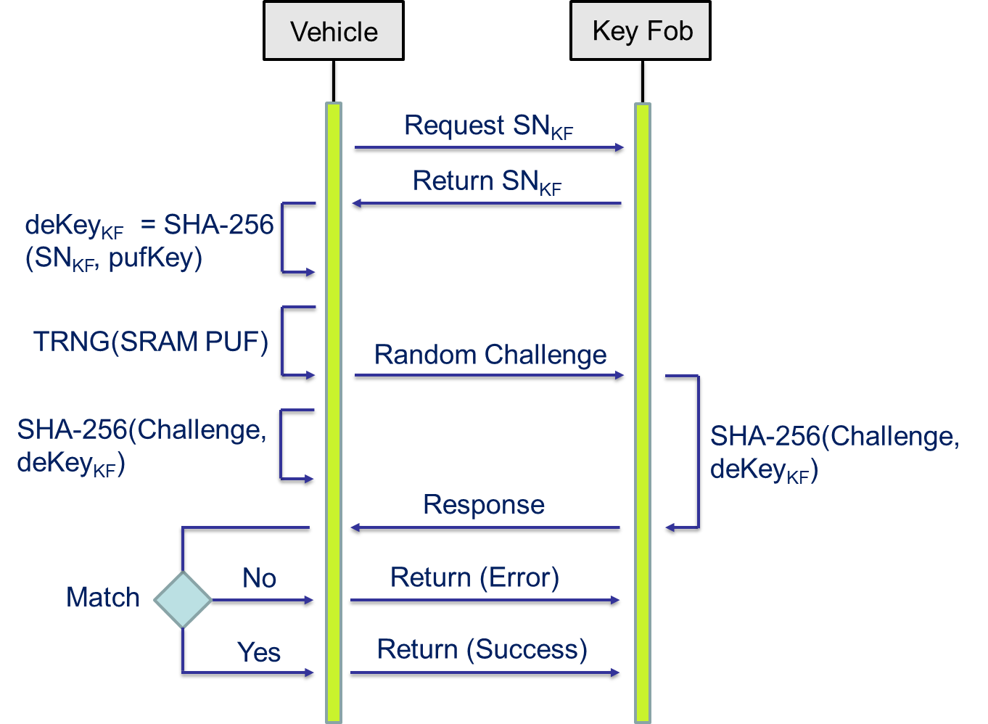
Appendix B.1 Key Fob Asymmetric Authentication
*TRNG: True Random Number Generator
*SN_{KF}: Serial Number of Key Fob
*pufKey: SRAM PUF Key
*deKey_{KF}: Derived Key of Key Fob

Slide 29
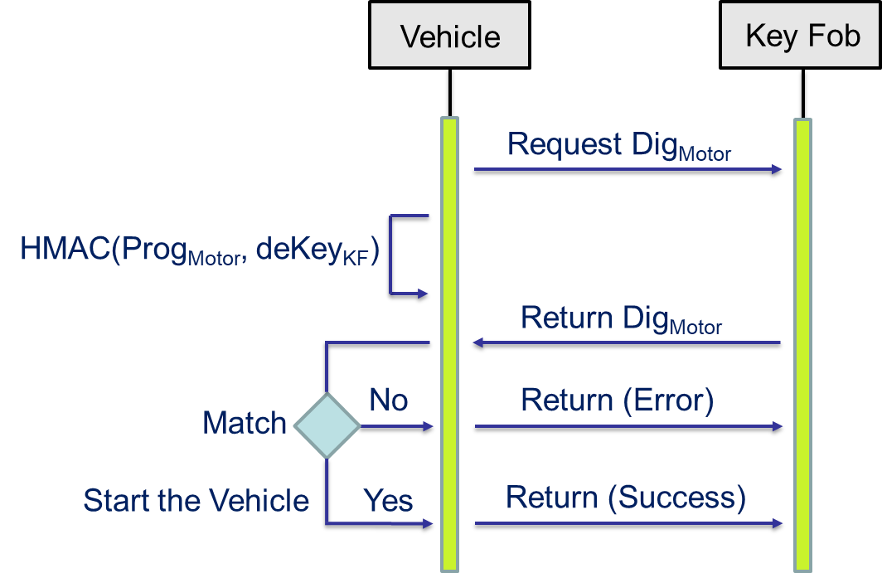
Appendix B.2 Software Integrity Verification
*Prog_{Motor}: Motor Control Program
*Dig_{Motor}: HMAC Digest of Prog_{Motor}

